Slide 1
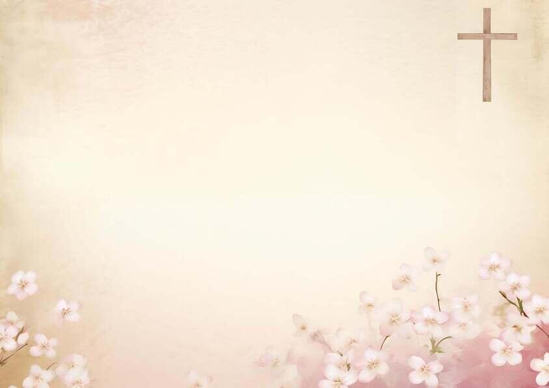
我深信在那各各他山顶
I Believe in a hill Called Mount Calvary
(S 179)

Slide 2
人一生在世如客旅转眼逝去，
世上并无一处能久留；
There are things
as we travel this earth’s shifting sands
That transcend all the reason of man;
1/3

Slide 3
虽然有名利财宝一生在追求，
但不能使我永远拥有。
But the things that matter the most
in this world,
They can never be held in our hand.

Slide 4
我深信在那各各他山顶
我救主曾为我被挂；
I believe in a hill called Mount Calvary
I’ ll believe whatever the cost;

Slide 5
当岁月渐渐消失，
世界成过去，
And when time has surrendered
and earth is no more,

Slide 6
我仍愿倚靠古旧十架。
I’ll still cling to that old rugged cross.

Slide 7
我深信基督既为人受死十架，
今日能使你生命改变；
I believe that the Christ who was slain on that cross
Has the power to change lives today;
2/3

Slide 8
因为祂曾改变我。赐我新生命，
我今愿靠近十架身边。
For He changed me completely,
a new life is mine,
That is why by the cross I will stay.

Slide 9
我深信在那各各他山顶
我救主曾为我被挂；
I believe in a hill called Mount Calvary
I’ ll believe whatever the cost;

Slide 10
当岁月渐渐消失，
世界成过去，
And when time has surrendered
and earth is no more,

Slide 11
我仍愿倚靠古旧十架。
I’ll still cling to that old rugged cross.

Slide 12
我深信人生雖然如謎難測透，
有一天這一切將結束；
I believe that this life with its great mysteries
Surely someday will come to an end;
3/3

Slide 13
但因信我能得勝死亡與黑暗，
到天家與我良友同住。
But faith will conquer the darkness and death
And will lead me at last to my Friend.

Slide 14
我深信在那各各他山顶
我救主曾为我被挂；
I believe in a hill called Mount Calvary
I’ ll believe whatever the cost;

Slide 15
当岁月渐渐消失，
世界成过去，
And when time has surrendered
and earth is no more,

Slide 16
我仍愿倚靠古旧十架。
I’ll still cling to that old rugged cross.

Slide 17
我深信在那各各他山顶
我救主曾为我被挂；
I believe in a hill called Mount Calvary
I’ ll believe whatever the cost;

Slide 18
当岁月渐渐消失，
世界成过去，
And when time has surrendered
and earth is no more,

Slide 19
我仍愿倚靠古旧十架。
I’ll still cling to that old rugged cross.
❤

